Slide 1
Autoencoder
An autoencoder is a type of artificial neural network used to learn efficient data codings in an unsupervised manner.
The aim of an autoencoder is to learn a representation (encoding) for a set of data, typically for dimensionality reduction, by training the network to ignore signal “noise”.
As like principal component analysis (PCA) but there are differences

Slide 2
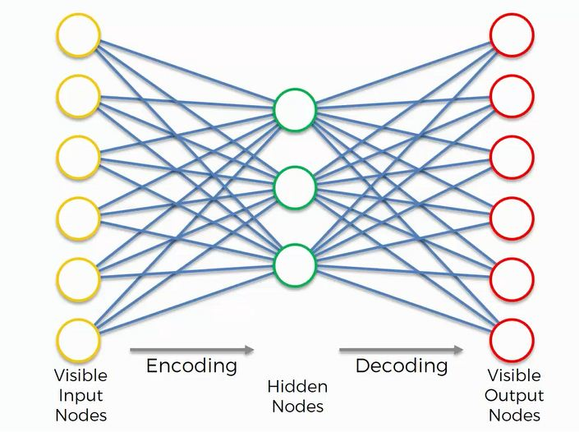
Autoencoder

Slide 3
Cont…
Encoding :- Used for transfer data from left to right, reduce the dimension of input and save data in hidden layers.
Hidden layers:- used activation function [Tangent hyperbolic:- (-1,1)]
Decoding :- used for decode the data from hidden layer to output layers and obtained same data as input layer. Used activation function [Sigmoid + softmax (max value became 1, rest zero)]

Slide 4
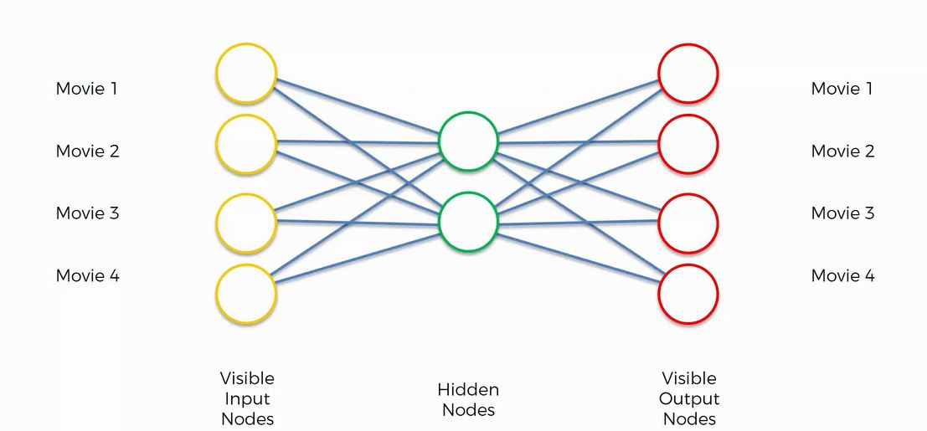
Autoencoder

Slide 5

Autoencoder

Slide 6
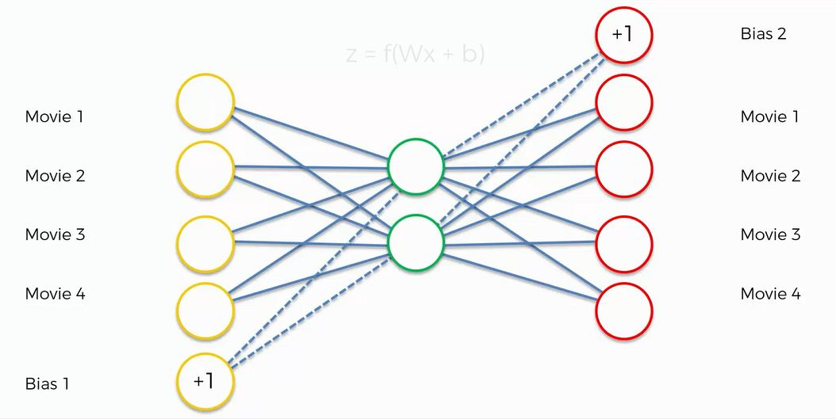
Autoencoder
Bias is used to adjust the value of neurons
If the value of the i/p and o/p is not same then loss function is calculated and go to back propagation and it will be continuous till loss is not reduced.

Slide 7
Types of AE
There are, basically, 7 types of Autoencoders:
Stack Autoencoder
Denoising Autoencoder
Sparse Autoencoder
Deep Autoencoder
Contractive Autoencoder
Undercomplete Autoencoder
Convolutional Autoencoder
Variational Autoencoder

Slide 8
Deep Autoencoder
Deep Autoencoders consist of two identical deep belief networks, One network for encoding and another for decoding.
Typically deep Autoencoders have 4 to 5 layers for encoding and the next 4 to 5 layers for decoding.

Slide 9
We use unsupervised layer-by-layer pre-training for this model.
The layers are Restricted Boltzmann Machines which are the building blocks of deep-belief networks.
Deep Autoencoders are useful in topic modelling, or statistical modelling of abstract topics distributed across a collection of documents. They are also capable of compressing images into 30 number vectors.

Slide 10
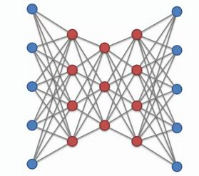
Deep Autoencoder

Slide 11
Varational autoencoder
Variational Autoencoders (VAEs) are a type of deep learning model that can be used for unsupervised learning tasks such as image generation, data compression, and anomaly detection.
VAEs are particularly useful because they allow for the generation of new data that is similar to the training data, while also learning a lower-dimensional representation of the data that captures its underlying structure.

Slide 12
Advantages of VAEs
VAEs is their ability to generate new data that is similar to the training data.
VAEs is their ability to learn a lower-dimensional representation of the data.

Slide 13
Theory of varational autoencoder
The basic structure of a VAE consists of an encoder and a decoder network. The encoder network maps the input data into a lower-dimensional latent space, while the decoder network maps the latent representation back to the original data space.
The encoder and decoder networks are typically neural networks, and they are trained jointly to minimize a loss function that measures the difference between the original input data and the reconstructed data.
VAE also includes a probabilistic model that describes the distribution of the latent variables. (Gaussian distribution with mean and variance)

Slide 14
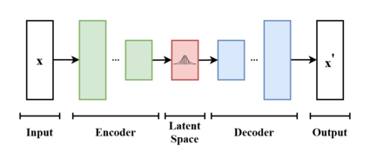
Mathematics involved in VAEs

Slide 15
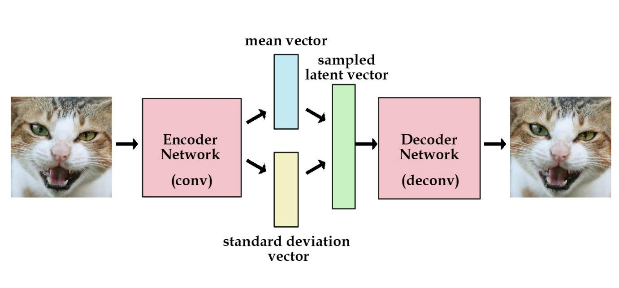
Variational Autoencoder

Slide 16
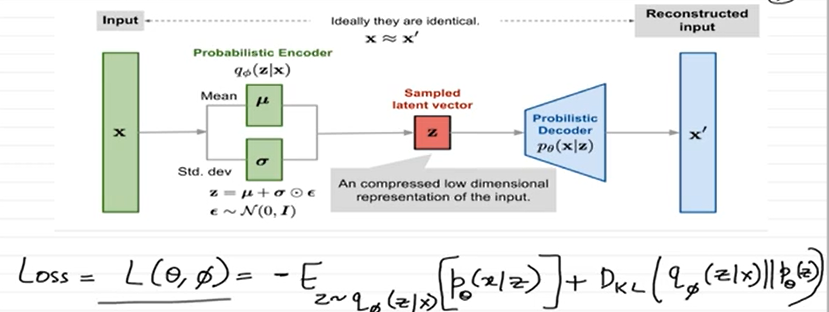

Slide 17
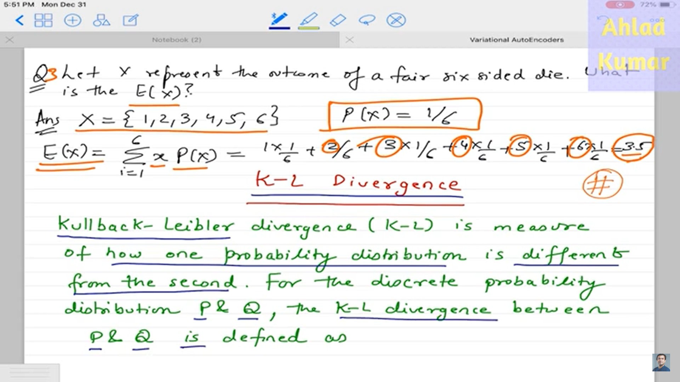
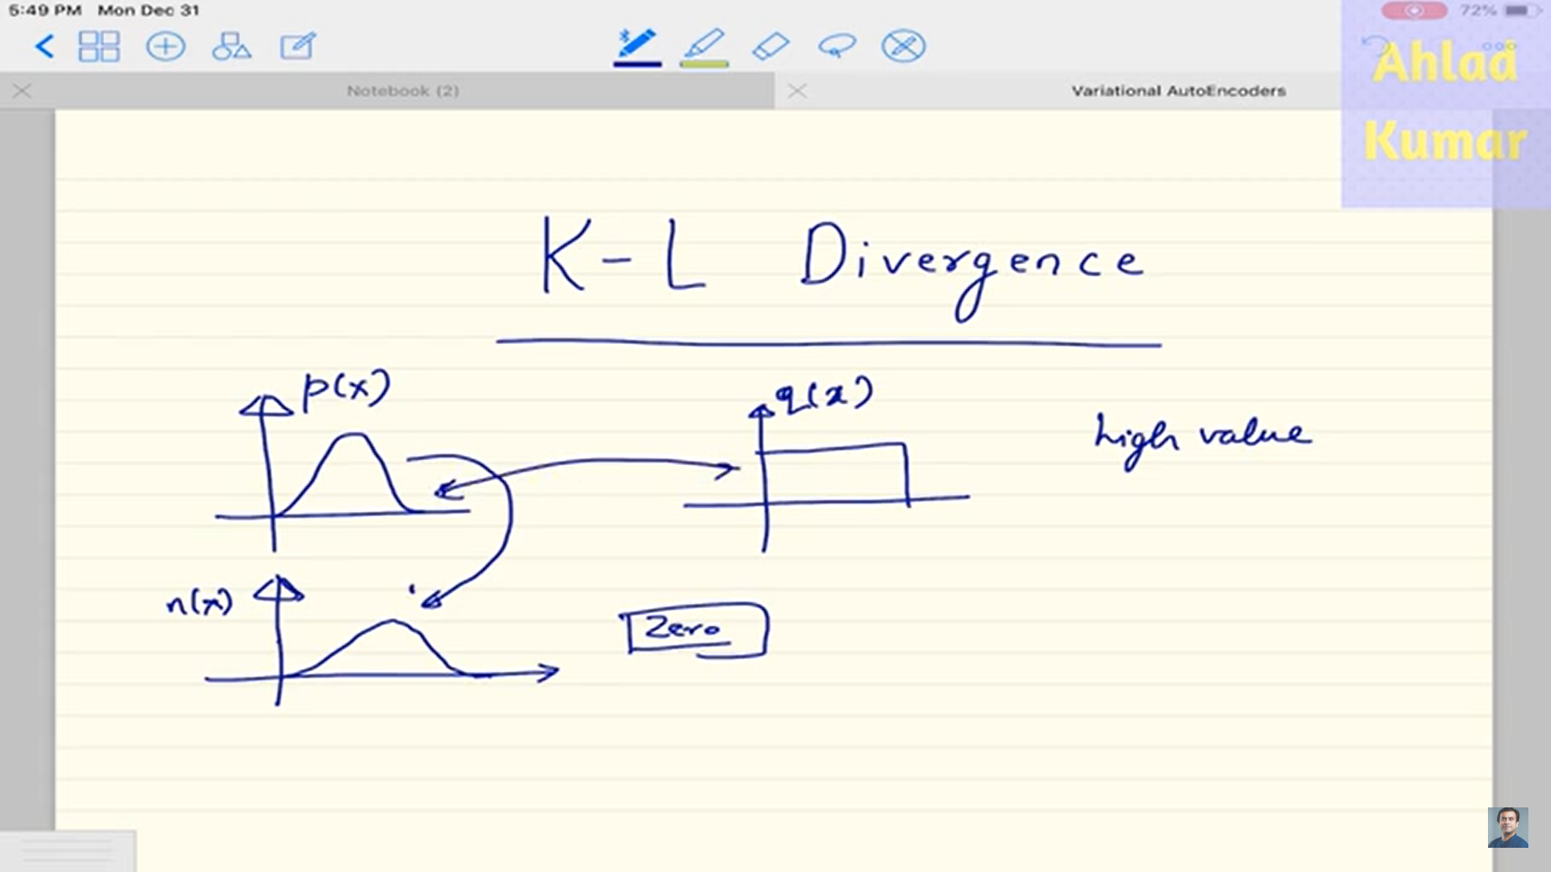

Slide 18
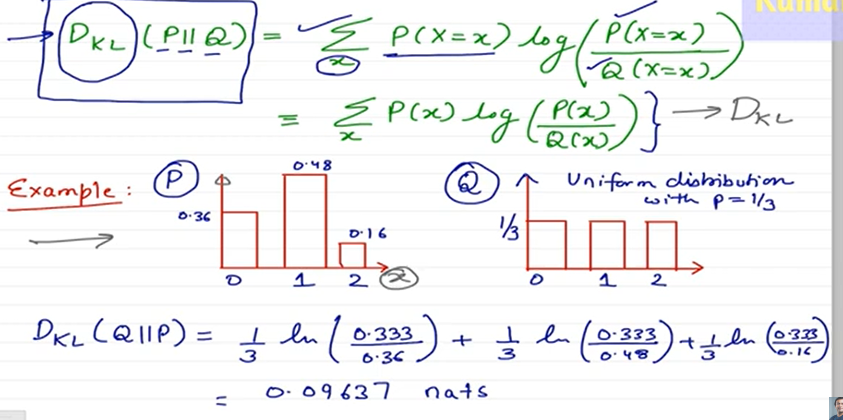

Slide 19
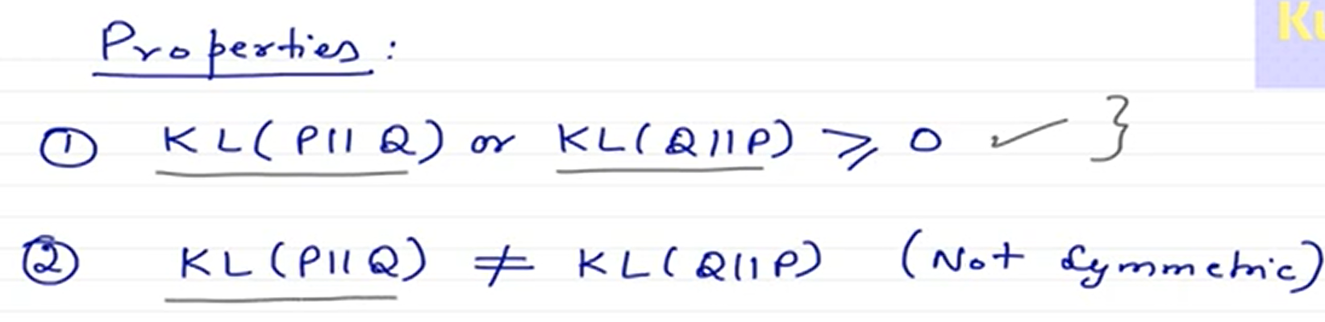

Slide 20
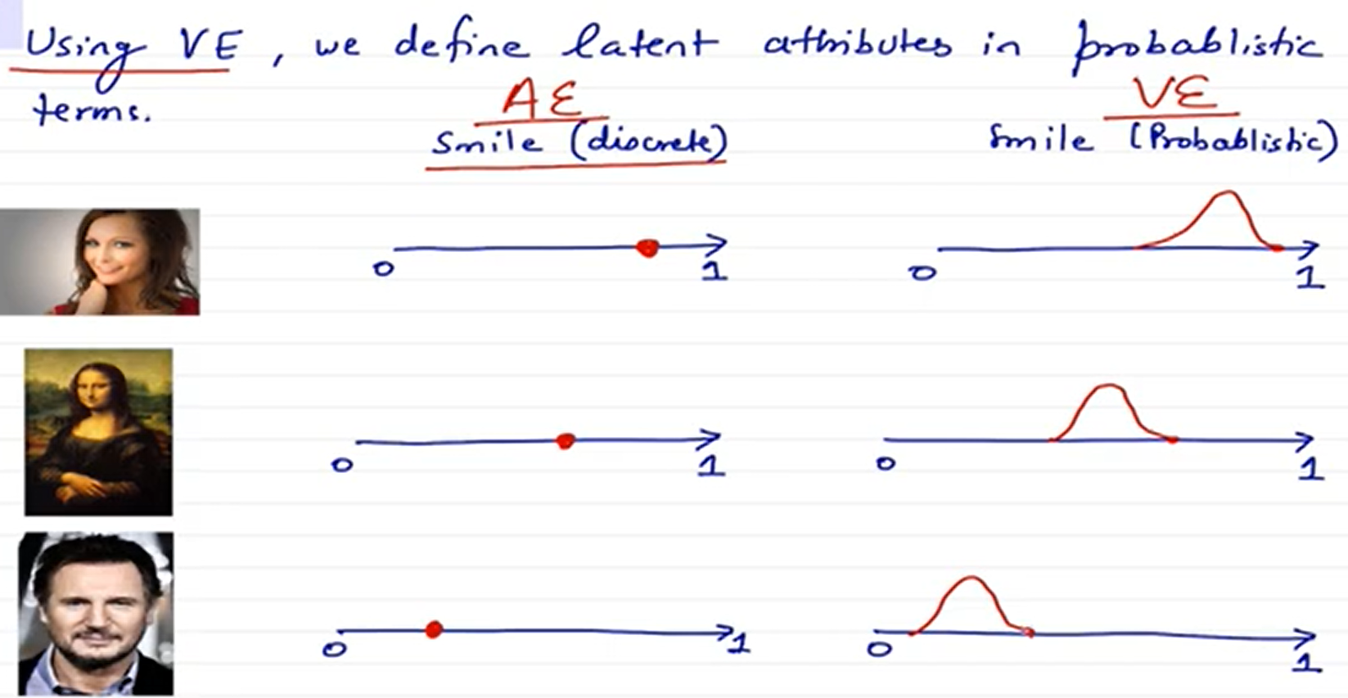

Slide 21
AE Applications
Dimensionality Reduction
Image Compression
Image Denoising
Feature Extraction
Image generation
Sequence to sequence prediction
Recommendation system

